Slide 1
AZ-203.6 Module 03: Azure API Management
Subtitle or speaker name
Notes:
In this module, you will cover:
API Management.
Securing APIs.
Defining API Policies.

Slide 2
Topics
Azure API Management
Securing APIs
Defining API policies
Notes:
These are the topics that will be covered in this module.

Slide 3
Lesson 01: Azure API Management
Notes:
In this lesson, you will cover:
Azure API Management.
Terminology.

Slide 4
Azure API Management (APIM)
Streamlines the process of common tasks necessary for creating an API for external use
Tasks include:
Creating a successful and useful developer portal
Securing API endpoints from anonymous or unwanted access
Managing existing developer access through cache mechanisms, throttling, and other policies
Building a monitoring and analytics platform to diagnose issues and monitor adoption
Providing business users and developers with deep insights into how each API is specifically used
Notes:
API Management (APIM) helps organizations publish APIs to external, partner, and internal developers to unlock the potential of their data and services. Businesses everywhere are seeking to extend their operations as a digital platform, creating new channels, finding new customers and driving deeper engagement with existing ones. API Management provides the core competencies to ensure a successful API program through developer engagement, business insights, analytics, security, and protection. You can use Microsoft Azure API Management (APIM) to take any back end and launch a full-fledged API program based on it.

Slide 5
Terminology
Back-end API
A HTTP service you implement with your business logic
Front-end API
A HTTP service façade hosted by API Management to obfuscate your back-end API
Product
One or more APIs, along with a usage quota and terms of use
Operation
A specific operation in the Frontend API that correlates to a specific request/response from the back-end API
Notes:
Backend API
An HTTP service that implements your API and its operations.
Frontend API/APIM API
An APIM API does not host APIs. It creates facades for your APIs to customize the facade according to your needs without touching the back-end API.
APIM product
A product contains one or more APIs as well as a usage quota and the terms of use. You can include a number of APIs and offer them to developers through the Developer portal.
APIM API operation
Each APIM API represents a set of operations available to developers. Each APIM API contains a reference to the back-end service that implements the API, and its operations map to the operations implemented by the back-end service.

Slide 6
Terminology (continued)
Version
A breaking change to the Frontend API
Existing application will not be required to change its code as you update or change the Frontend API
Revision
A nonbreaking change to a Frontend API
Developer portal
An interface that developers use to learn about your API and test operations
Notes:
Version
Sometimes you want to publish new or different API features to some users, while others want to remain with the API that currently works for them.
Revision
When your API is ready to go and starts to be used by developers, you usually need to be careful when making changes to that API, and at the same time, avoid disrupting callers of your API. It's also useful to let developers know about the changes that you made.
Developer portal
Your customers (developers) should use the Developer portal to access your APIs. The Developer portal can be customized.

Slide 7




Back-end and front-end APIs
Front end
Back end
APIM
Modern API
API 1
Legacy API
API 2
Search
Cognitive Services
Notes:
APIs are the foundation of an API Management service instance. Each API contains a reference to the back-end service that implements the API.

Slide 8
APIs and operations
API
Operation
Cognitive Services
Operation
Legacy API
Operation
Notes:
To use API Management, administrators create APIs. Each API consists of one or more operations. Each API represents a set of operations that are available to developers. To use an API, developers can call the API's operation.
Each API's operations map to the operations implemented by the back-end service. Operations in API Management are highly configurable, providing control over URL mapping, query and path parameters, request and response content, and operation response caching. You can also implement rate limit, quotas, and IP restriction policies at the API or individual operation level.

Slide 9
Products and APIs
Free products
Paid products
Enterprise API
Basic
Advanced API
Notes:
Each API can be added to one or more products. To use an API, developers subscribe to a product that contains that API, which will get them a key to access the API.
Products are the means by which developers access APIs. Products in API Management have one or more APIs. Developers configure the products with a title, description, and terms of use. Products can be Open or Protected. You must subscribe to protected products before you can use them. However, you can use open products without a subscription.

Slide 10

Creating an API Management instance
Create and manage APIs
Each API contains one or more sets of operations
Operations are configurable, granting control over:
URL mapping
Query and path parameters
Request and response content
Operation response caching
Notes:
To use API Management, administrators create APIs. Each API consists of one or more operations, and each API can be added to one or more products. To use an API, developers subscribe to a product that contains that API, and then they can call the API's operation, subject to any usage policies that might be in effect.

Slide 11
Demo: Create an Azure API Management service instance
Notes:
API Management provides the core competencies to ensure a successful API program through developer engagement, business insights, analytics, security, and protection. APIM enables you to create and manage modern API gateways for existing back-end services hosted anywhere.
This revision of the course does not ship with demo instructions. For each demo, you will be given a list of specific tasks you should demonstrate to your students. The flow, content and structure of your demo is left to you to decide as an instructor.
In this demo, you should show students how to:
Create a new API Management instance.
Observe the developer and publisher portals.

Slide 12



Manage using Git
>_
git clone
git pull
https://{name}.scm.azure-api.net
https://{name}.management.azure-api.net
git pull
SAVE
git push
Configuration
database
Git repo
DEPLOY
Notes:
Each API Management service instance maintains a configuration database that contains information about the configuration and metadata for the service instance. You can make changes to the service instance by changing a setting in the Azure portal, by using a PowerShell cmdlet, or by making a REST API call. In addition to these methods, you can also manage your service instance configuration by using Git.
When you make changes to your service by using the Azure portal, PowerShell cmdlets, or the REST API, you are managing your service configuration database by using the https://{name}.management.azure-api.net endpoint. This is depicted in the diagram on the slide. The diagram also depicts how you can manage your service configuration by using Git and the Git repository for your service, which is located at https://{name}.scm.azure-api.net.

Slide 13
Lesson 02: Securing APIs
Notes:
In this lesson, you will cover:
Subscriptions.
Client certificates.

Slide 14
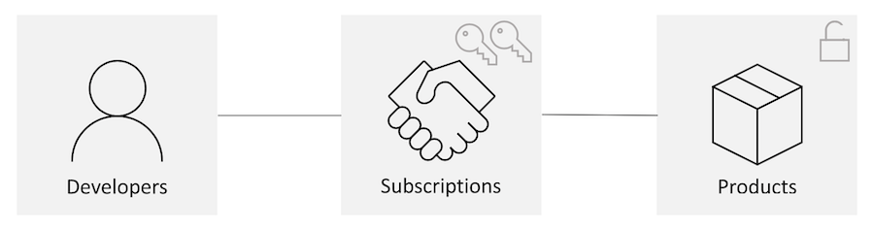
Subscriptions
Subscriptions tie Developers together with Products
A Developer will sign up for a subscription to get access to various products
The subscription will grant the Developer access to subscription keys
The subscription keys can be used to access specific products
Notes:
When you publish APIs through API Management, it's easy and common to secure access to those APIs by using subscription keys. Developers who need to consume the published APIs must include a valid subscription key in HTTP requests when they make calls to those APIs. Otherwise, the calls are rejected immediately by the API Management gateway. They aren't forwarded to the back-end services.
To get a subscription key for accessing APIs, a subscription is required. A subscription is essentially a named container for a pair of subscription keys. Developers who need to consume the published APIs can get subscriptions. And they don't need approval from API publishers. API publishers can also create subscriptions directly for API consumers.
Traditionally, subscriptions in API Management were always associated with a single API product scope. Developers found the list of products on the Developer portal. Then they'd submit subscription requests for the products they wanted to use. After a subscription request is approved, either automatically or by API publishers, the developer can use the keys in it to access all APIs in the product.

Slide 15
Client certificates
<!-- checking the expiration date -->
<choose>
<when condition="@(context.Request.Certificate == null || context.Request.Certificate.NotAfter < DateTime.Now)" >
<return-response><set-status code="403" reason="Invalid client certificate" /></return-response></when></choose>
<!-- checking the issuer and subject -->
<choose>
<when condition="@(context.Request.Certificate == null || context.Request.Certificate.Issuer != "trusted-issuer" || context.Request.Certificate.SubjectName != "expected-subject-name")" >
<return-response><set-status code="403" reason="Invalid client certificate" /></return-response></when></choose>
Notes:
API Management provides the capability to secure access to APIs (that is, client to API Management) by using client certificates. Currently, you can check the thumbprint of a client certificate against a desired value. You can also check the thumbprint against existing certificates uploaded to API Management.
Checking the expiration date
Policies can be configured to check if the certificate is expired.
Checking the issuer and subject
Policies can be configured to check the issuer and subject of a client certificate.

Slide 16
Client certificates (continued)
<!-- checking the thumbprint -->
<choose>
<when condition="@(context.Request.Certificate == null || context.Request.Certificate.Thumbprint != "desired-thumbprint")" >
<return-response><set-status code="403" reason="Invalid client certificate"
/></return-response></when></choose>
<!-- checking a thumbprint against certificates uploaded to API Management -->
<choose>
<when condition="@(context.Request.Certificate == null || !context.Deployment.Certificates.Any(c => c.Value.Thumbprint == context.Request.Certificate.Thumbprint))" >
<return-response><set-status code="403" reason="Invalid client certificate"
/></return-response></when></choose>
Notes:
API Management provides the capability to secure access to APIs (that is, client to API Management) by using client certificates. Currently, you can check the thumbprint of a client certificate against a desired value. You can also check the thumbprint against existing certificates uploaded to API Management.
Checking the thumbprint
Policies can be configured to check the thumbprint of a client certificate.
Checking a thumbprint against certificates uploaded to API Management
Policies can be configured to check the thumbprint of a client certificate against certificates uploaded to API Management.

Slide 17
Demo: Protect an API by using OAuth 2.0 with Azure Active Directory and API Management
Notes:
This revision of the course does not ship with demo instructions. For each demo, you will be given a list of specific tasks you should demonstrate to your students. The flow, content and structure of your demo is left to you to decide as an instructor.
In this demo, you should show students how to:
Enable security for an Azure API Management API.
Create a user in Azure AD and use OAuth 2.0 to validate against the API using the new user.

Slide 18
Lesson 03: Defining API policies
Notes:
In this lesson, you will cover:
Policies.
Editing policies.
Advanced policy scenarios.

Slide 19
Policies
Collection of statements that are executed sequentially at the request or response of an API
Are a quick way to change the behavior of an API without code changes to the actual back-end API application
A comprehensive list of policy options can be found at API Management policies
(https://aka.ms/AA4gbik)
Notes:
In Azure API Management (APIM), policies are a powerful capability of the system that allow the publisher to change the behavior of the API through configuration. Policies are a collection of Statements that are executed sequentially on the request or response of an API. Popular Statements include format conversion from XML to JSON and call rate limiting to restrict the amount of incoming calls from a developer. Many more policies are available out of the box.

Slide 20
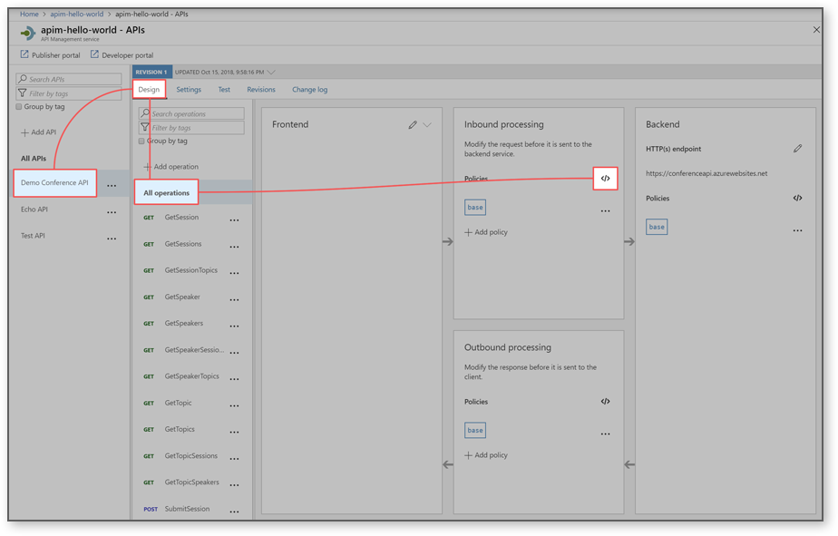
Editing policies
<policies>
<inbound>
<base />
</inbound>
<backend>
<base />
</backend>
<outbound>
<base />
</outbound>
<on-error>
<base />
</on-error>
</policies>
Notes:
The policy definition is an XML document that describes a sequence of inbound and outbound statements. The XML can be edited directly in the definition window. You can also select a predefined policy from the list that is provided to the right of the policy window. The statements applicable to the current scope are enabled and highlighted. Selecting an enabled statement adds the appropriate XML at the location of the cursor in the definition view.

Slide 21

Policy scopes
Global policies are invoked here.
<policies>
<inbound>
<cross-domain />
<base />
<find-and-replace from="xyz" to="abc" />
</inbound>
</policies>
Global policies
API
Policies
Notes:
If you have a policy at the global level and a policy configured for an API, then whenever that particular API is used both policies will be applied. API Management allows for deterministic ordering of combined policy statements using a special <base /> element.

Slide 22
Demo: Setting and editing Azure API Management policies
Notes:
In this demo you will configure the content and scope of a new inbound and outbound policy.
This revision of the course does not ship with demo instructions. For each demo, you will be given a list of specific tasks you should demonstrate to your students. The flow, content and structure of your demo is left to you to decide as an instructor.
In this demo, you should show students how to:
Create a new inbound and outbound policy for an API endpoint.
Create an API-level policy and observe how it is propagated down to endpoints.

Slide 23
Advanced policy scenarios – control flow
<choose>
<when condition="Boolean expression | Boolean constant">
<!-- one or more policy statements to be applied if the above condition is true -->
</when>
<when condition="Boolean expression | Boolean constant">
<!-- one or more policy statements to be applied if the above condition is true -->
</when>
<otherwise>
<!-- one or more policy statements to be applied if none of the above conditions are true -->
</otherwise>
</choose>
Notes:
The choose policy applies enclosed policy statements based on the outcome of evaluation of Boolean expressions, similar to an if-then-else or a switch construct in a programming language.
The control flow policy must contain at least one <when/> element. The <otherwise/> element is optional. Conditions in <when/> elements are evaluated in order of their appearance within the policy. Policy statement(s) enclosed within the first <when/> element with condition attribute equals true will be applied. Policies enclosed within the <otherwise/> element, if present, will be applied if all of the <when/> element condition attributes are false.

Slide 24
Advanced policy scenarios – forward request
<forward-request timeout="time in seconds" follow-redirects="true | false"/>
Back-end service
Operation
Notes:
The forward-request policy forwards the incoming request to the back-end service specified in the request context. The back-end service URL is specified in the API settings and can be changed by using the set backend service policy.
Removing this policy results in the request not being forwarded to the back-end service and the policies in the outbound section are evaluated immediately upon the successful completion of the policies in the inbound section.

Slide 25
Advanced policy scenarios – limit concurrency
<limit-concurrency key="expression" max-count="number">
<!-- nested policy statements -->
</limit-concurrency>
Service
Operation
Notes:
The limit-concurrency policy prevents enclosed policies from executing by more than the specified number of requests at any time. Upon exceeding that number, new requests will fail immediately with a 429 Too Many Requests status code.

Slide 26
Advanced policy scenarios – log to Event Hub
<log-to-eventhub logger-id="id of the logger entity" partition-id="index of the partition where messages are sent" partition-key="value used for partition assignment">
<!-- Expression returning a string to be logged -->
</log-to-eventhub>
Event Hub instance
Operation
Notes:
The log-to-eventhub policy sends messages in the specified format to an Event Hub defined by a Logger entity. As its name implies, the policy is used for saving selected request or response context information for online or offline analysis.

Slide 27
Advanced policy scenarios – mock response
<mock-response status-code="code" content-type="media type"/>
Operation
Response
Notes:
The mock response policy, as the name implies, is used to mock APIs and operations. It aborts normal pipeline execution and returns a mocked response to the caller. The policy always tries to return responses of highest fidelity. It prefers response content examples, whenever available. It generates sample responses from schemas, when schemas are provided and examples are not. If neither examples or schemas are found, responses with no content are returned.

Slide 28
Advanced policy scenarios – retry
<retry
condition="boolean expression or literal"
interval="retry interval in seconds"
max-interval="maximum retry interval in seconds"
delta="retry interval delta in seconds"
count="number of retry attempts">
<!-- One or more child policies. No restrictions -->
</retry>
Service
Operation
Notes:
The retry policy executes its child policies once and then retries their execution until the retry condition becomes false or retry count is exhausted.

Slide 29
Advanced policy scenarios – return response
<return-response response-variable-name="existing context variable">
<set-header/><set-body/><set-status/>
</return-response>
Status
Response
Modified
Operation
Body
Notes:
The return response policy aborts pipeline execution and returns either a default or custom response to the caller. Default response is 200 OK with no body. Custom response can be specified via a context variable or policy statements. When both are provided, the response contained within the context variable is modified by the policy statements before being returned to the caller.

Slide 30
Review
Azure API Management
Securing APIs
Defining API policies
Notes:
These are the topics that we discussed in this module.

